Slide 1

Berkeley Data analysis Project TWO stock data exploration
Team : D
Justin Agogbua
Ran Bi
Shuai Li

Slide 2
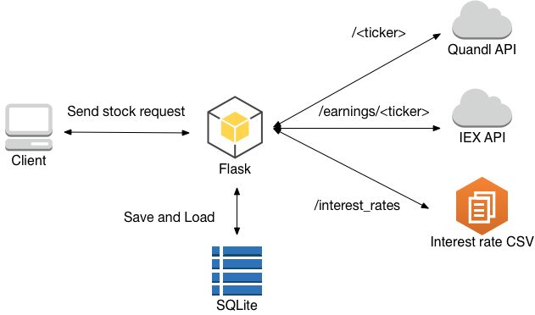
Structured data in sql.lite

Slide 3

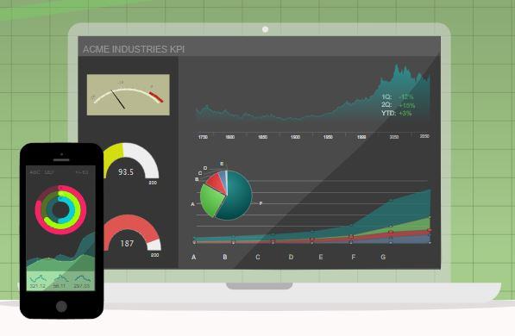
Highcharts.js is used as new lib
JavaScript based charting library.
Meant to enhance web applications by adding interactive charting capability.
Provides a wide variety of charts, including line charts, spline charts, area charts, bar charts, pie charts, etc.
Reference: https://www.highcharts.com/

Slide 4

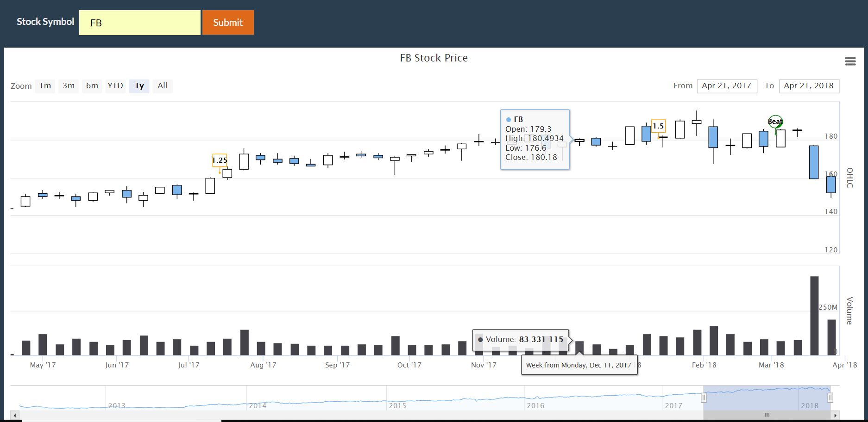
Interactive panel

Slide 5
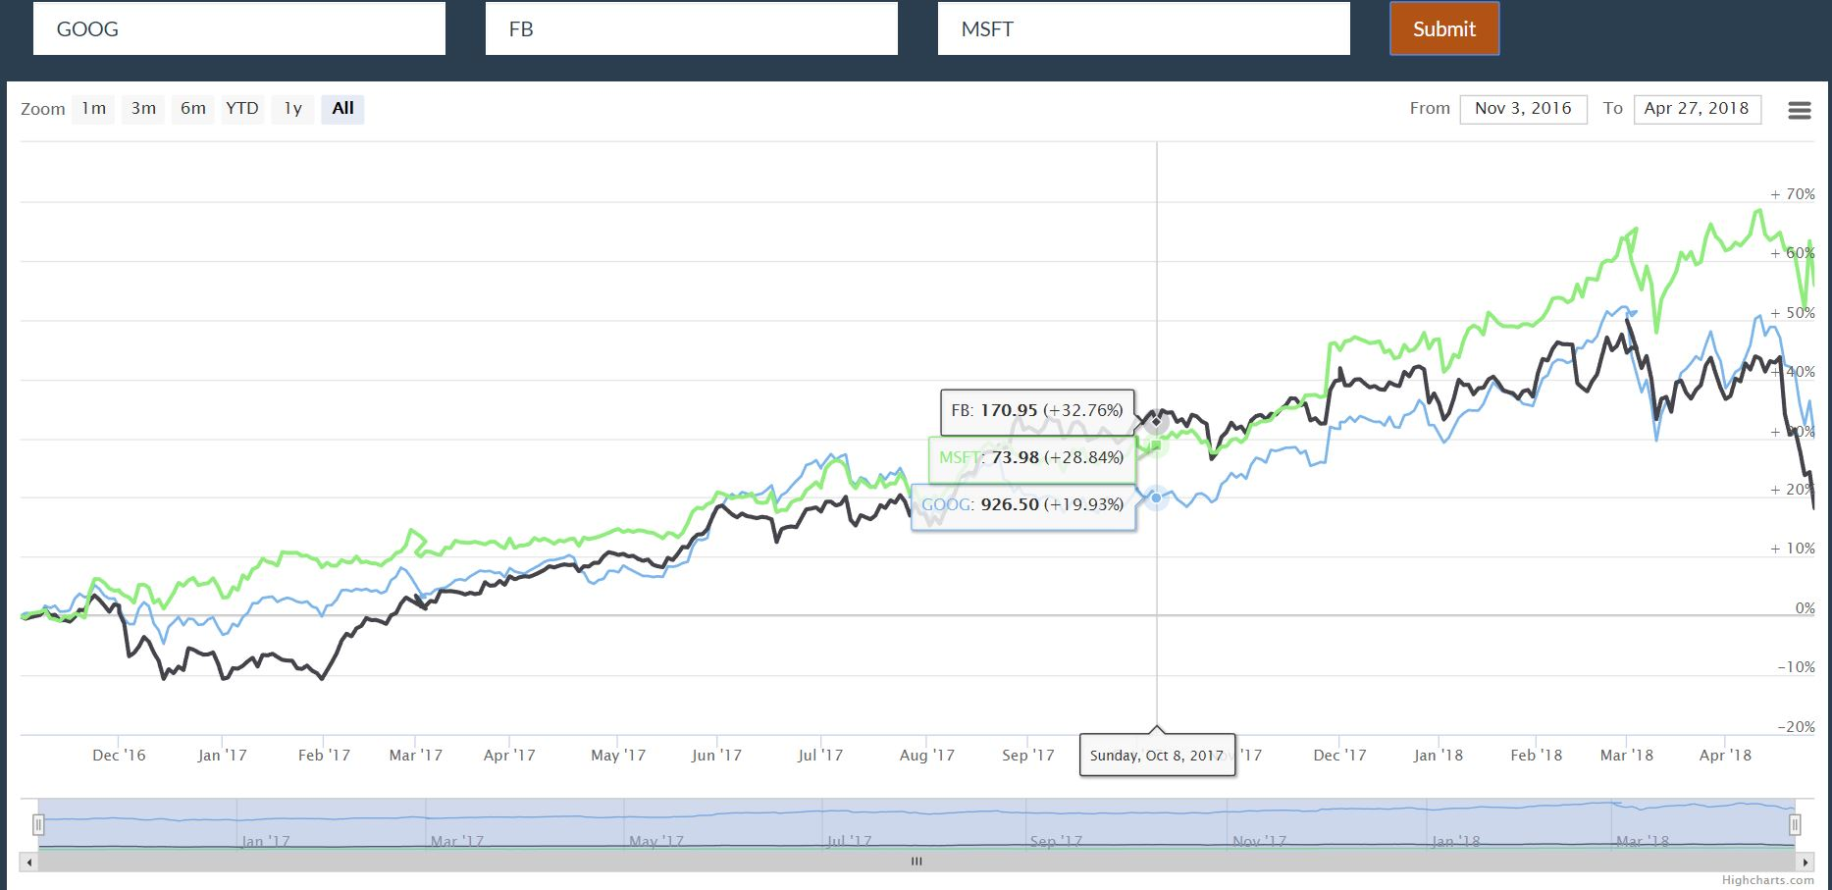
Stock performance comparison

Slide 6
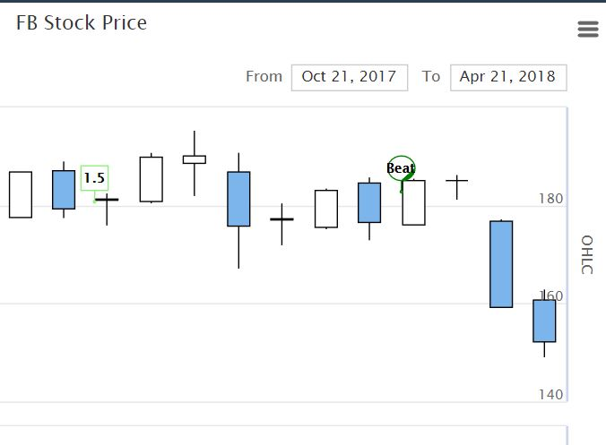
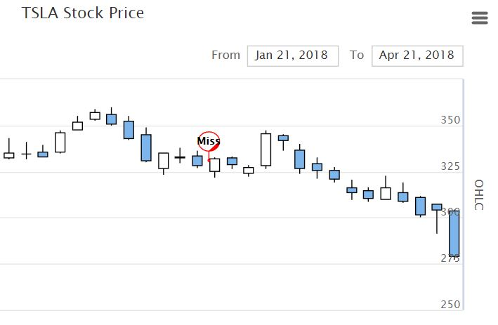
Earning call affects stock in short term

Slide 7
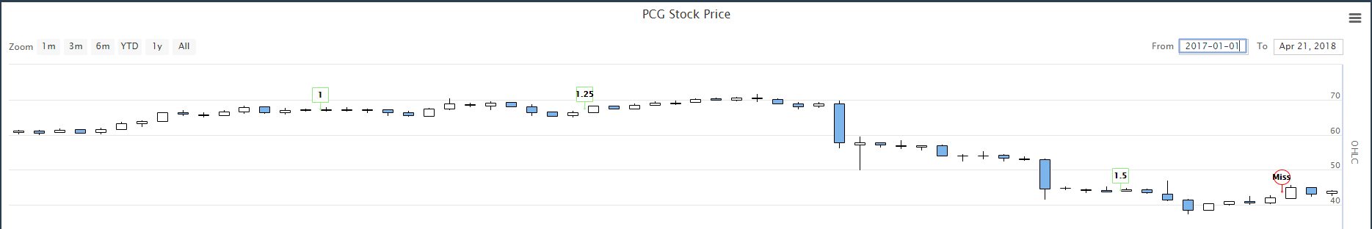
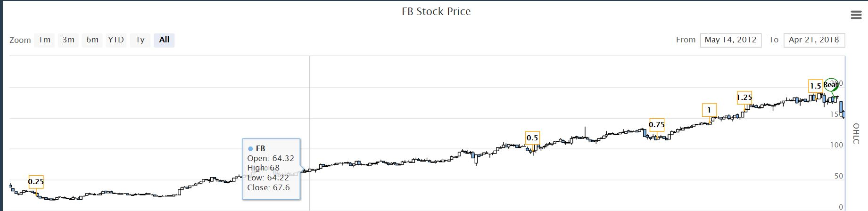
Interest rate affects stock

Slide 8
Limitation
Free stock data is only till April 2018.
Free earnings data is available one year from now.
Earning-stock price correlation is only shown for 1 quarter.
Interest rate increases dramatically in 2018, majority of which is not reflected in stock plot due to stock data limitation.

Slide 9
Demo

Slide 10
Thank you!

